Slide 1
Document Object Model (DOM)
David Tarvin, AIM Code School

Slide 2
What is the Document Object Model (DOM)?
It is a representation of the HTML that makes up the web page
When a web page is loaded, the following happens:
The JavaScript engine analyzes the HTML
The JavaScript converts the HTML into an internal format that the runtime environment can actually run.
This internal format is called the DOM tree.
The act of analyzing and converting is called parsing the document.
The browser then builds up a model of the document’s structure
The browser then uses the model to draw the page on the screen
The model of the document is a live data structure that you can read from and change
When it is modified, the page on the screen is updated to reflect the changes

Slide 3
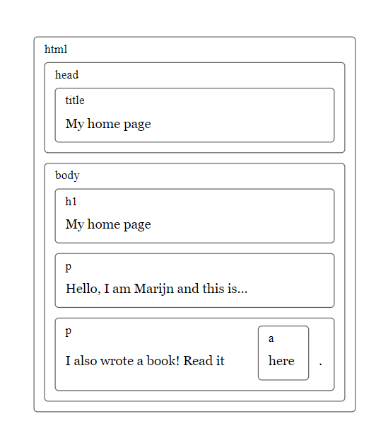
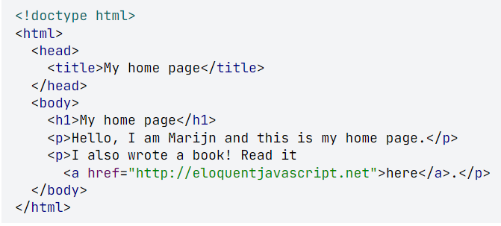
An HTML document is like a series of nested boxes. Tags such as <body> and </body> enclose other tags, which in turn contain other tags or text.

Slide 4
What is the Document Object Model (DOM)? (cont’d)
The data structure the browser uses to represent the HTML document follows this nested box shape
For each box, there is an object with which we can interact to find out things such as:
What HTML tag it represents
Which boxes and text it contains
This representation is called the Document Object Model, or DOM, for short
The global variable document gives us access to these objects
Its documentElement property refers to the object representing the HTML tag
It also provides the properties head and body, which hold the objects for those elements

Slide 5
Trees
A DOM is like a tree in that it is composed of many branches
Each element is referred to as a node
Each node may refer to other nodes, referred to as children, which in turn may have their own children
For a data structure to be a tree, it must have the following:
A branching structure
No cycles (a node may not contain itself, directly or indirectly)
A single, well-defined root (the root of the DOM is document.documentElement

Slide 6
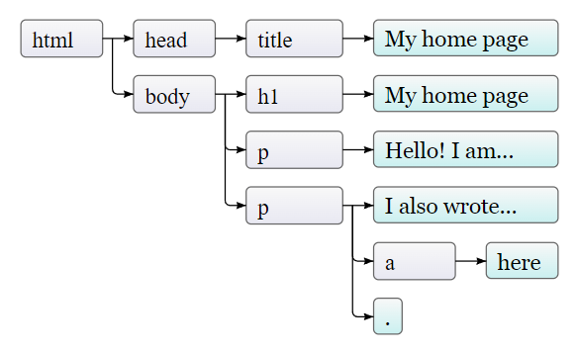
Trees (cont’d)
Nodes for regular elements, which represent HTML tags, determine the structure of the document
Those nodes can have child nodes. An example is document.body
Some child nodes can be leaf nodes containing pieces of text or HTML comments
In the picture, the leaves are text nodes, and the arrows indicate parent-child relationships between nodes

Slide 7
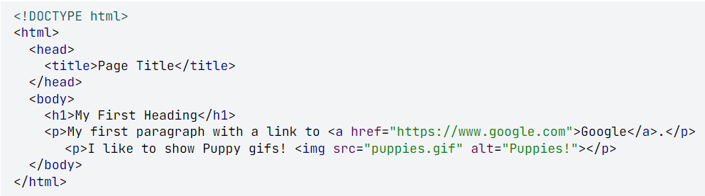
Quiz Time!!!
How many children does the body have?
How many root nodes are there?
Is DOCTYPE the root element?
Is the img element a node, given that it’s self closing?
Is the a node a child of anyone? If so, who?
How many total nodes are there in the tree?

Slide 8

DOM Construction Order
Once the HTML is parsed in the browser, the DOM gets constructed depth first from top to bottom
This means the browser starts at the top, then includes elements down and deeper into nested elements before going down
html
--head
----title
--body
----h1
----p (first one)
----p (second one)
------a

Slide 9
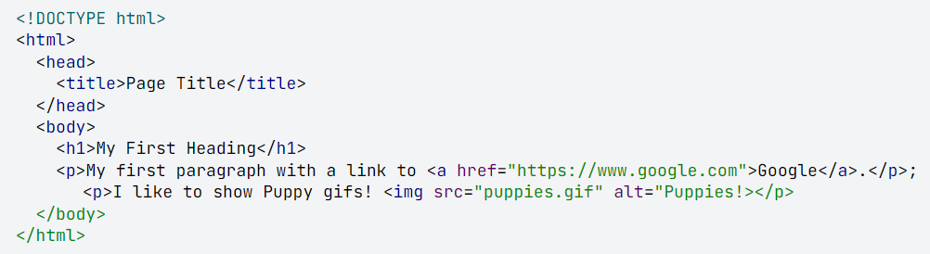
DOM Construction Order (cont)
In what order are these elements constructed?
html
--head
----title
--body
----h1
----p (first one)
------a
----p (second one)
------img

Slide 10
Why do we need to put the JavaScript <script> tag at the bottom of the body instead of in the <head> element?

